Slide 1
Identifying Nashville’s Popular Pythonistas with NetworkX
November 16, 2017
Stephen Bailey

Slide 2

Notes:
* You're new to Nashville. You're ready to start meeting people, making friends, expanding your network. But you don't want to get pigeon-holed into just one group, i.e. the people you might already know / are comfortable with. Maybe you're trying to market yourself / a product.
* What groups should you join? Who should you talk to in those groups? Wouldn't you rather be invited into a group than just show up at one?

Slide 3
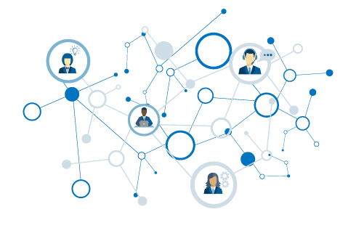
Popular Pythonistas
What is a network?
Using graphs
Ranking MeetUp groups
Ranking MeetUp people

Slide 4
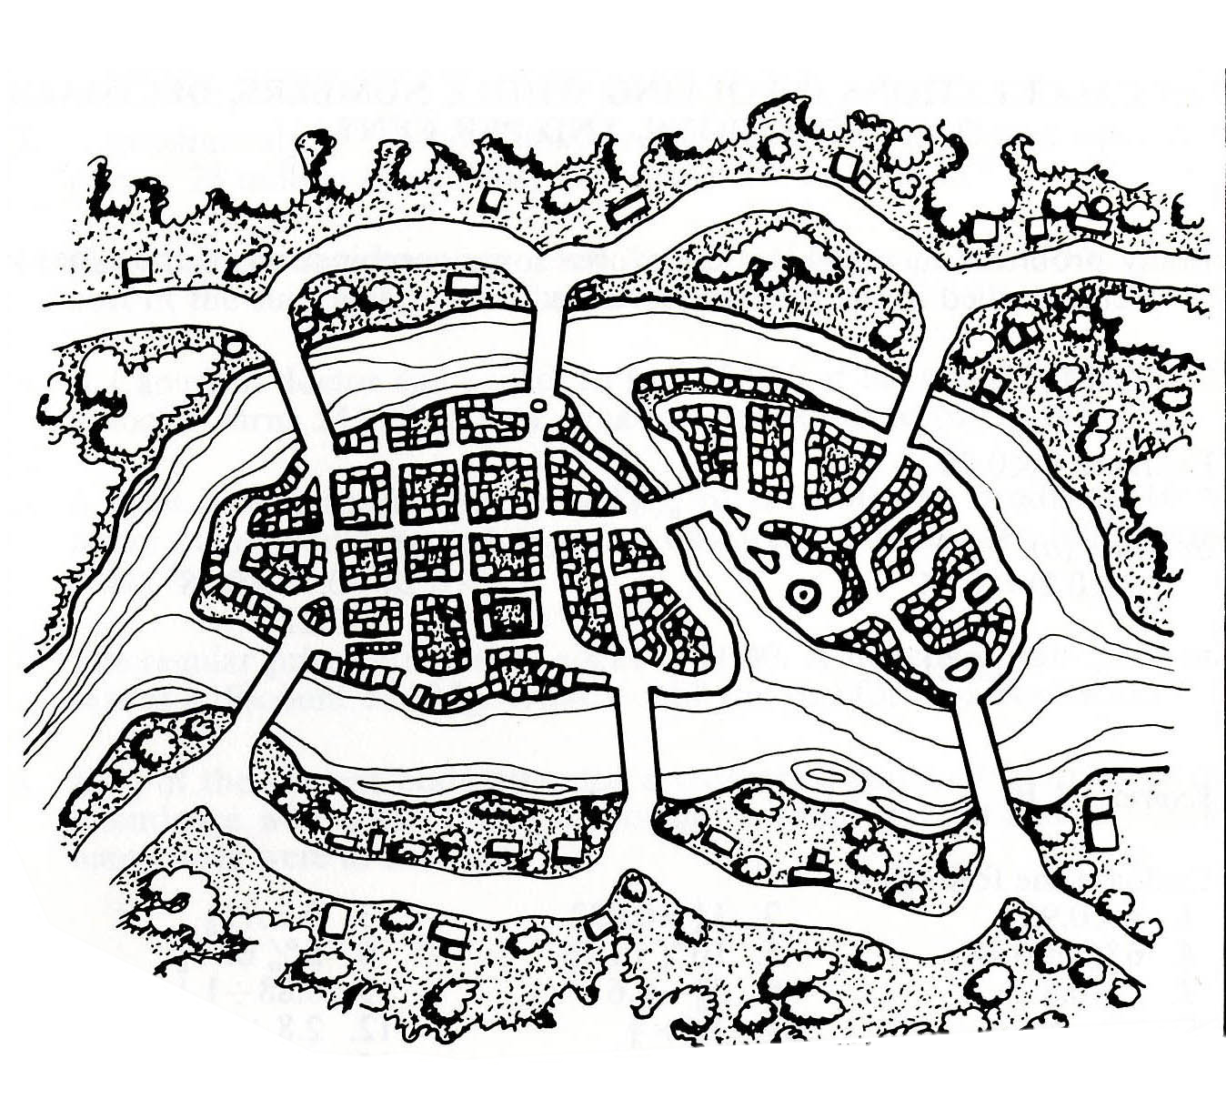
Can you traverse every bridge just once?
2
1
3
4
5
6
7

Slide 5
2
1
3
4
5
6
7

Slide 6
A
2
1
3
C
B
4
5
6
7
D

Slide 7
A
2
1
3
C
B
4
5
6
7
D

Slide 8
Graph
A
Node
B has the most connections
B
C
Edge
D
A & D are on the “outside” – they are not connected to each other
Notes:
Without knowing anything about this system, what is one thing you might say?
B seems to be the most “important” place – has the most connections.
B and C are seem to be more central to the graph – A and D are both on the edges

Slide 9
1
1
To travel into AND out of a node, requires 2 steps (or 4 or 6…).
Therefore… either:
All nodes are even.
Exactly two nodes are odd.
2
2
1
3
2
Notes:
Without knowing anything about this system, what is one thing you might say?
B seems to be the most “important” place – has the most connections.
B and C are seem to be more central to the graph – A and D are both on the edges

Slide 10
Four nodes with odd number of edges!
3
5
3
3
Notes:
Without knowing anything about this system, what is one thing you might say?
B seems to be the most “important” place – has the most connections.
B and C are seem to be more central to the graph – A and D are both on the edges

Slide 11
That’s the ticket…
3
4
3
2
Notes:
Without knowing anything about this system, what is one thing you might say?
B seems to be the most “important” place – has the most connections.
B and C are seem to be more central to the graph – A and D are both on the edges

Slide 12
Graphs
Useful for understanding relationships.
Describe topology (arrangement) of networks.

Slide 13
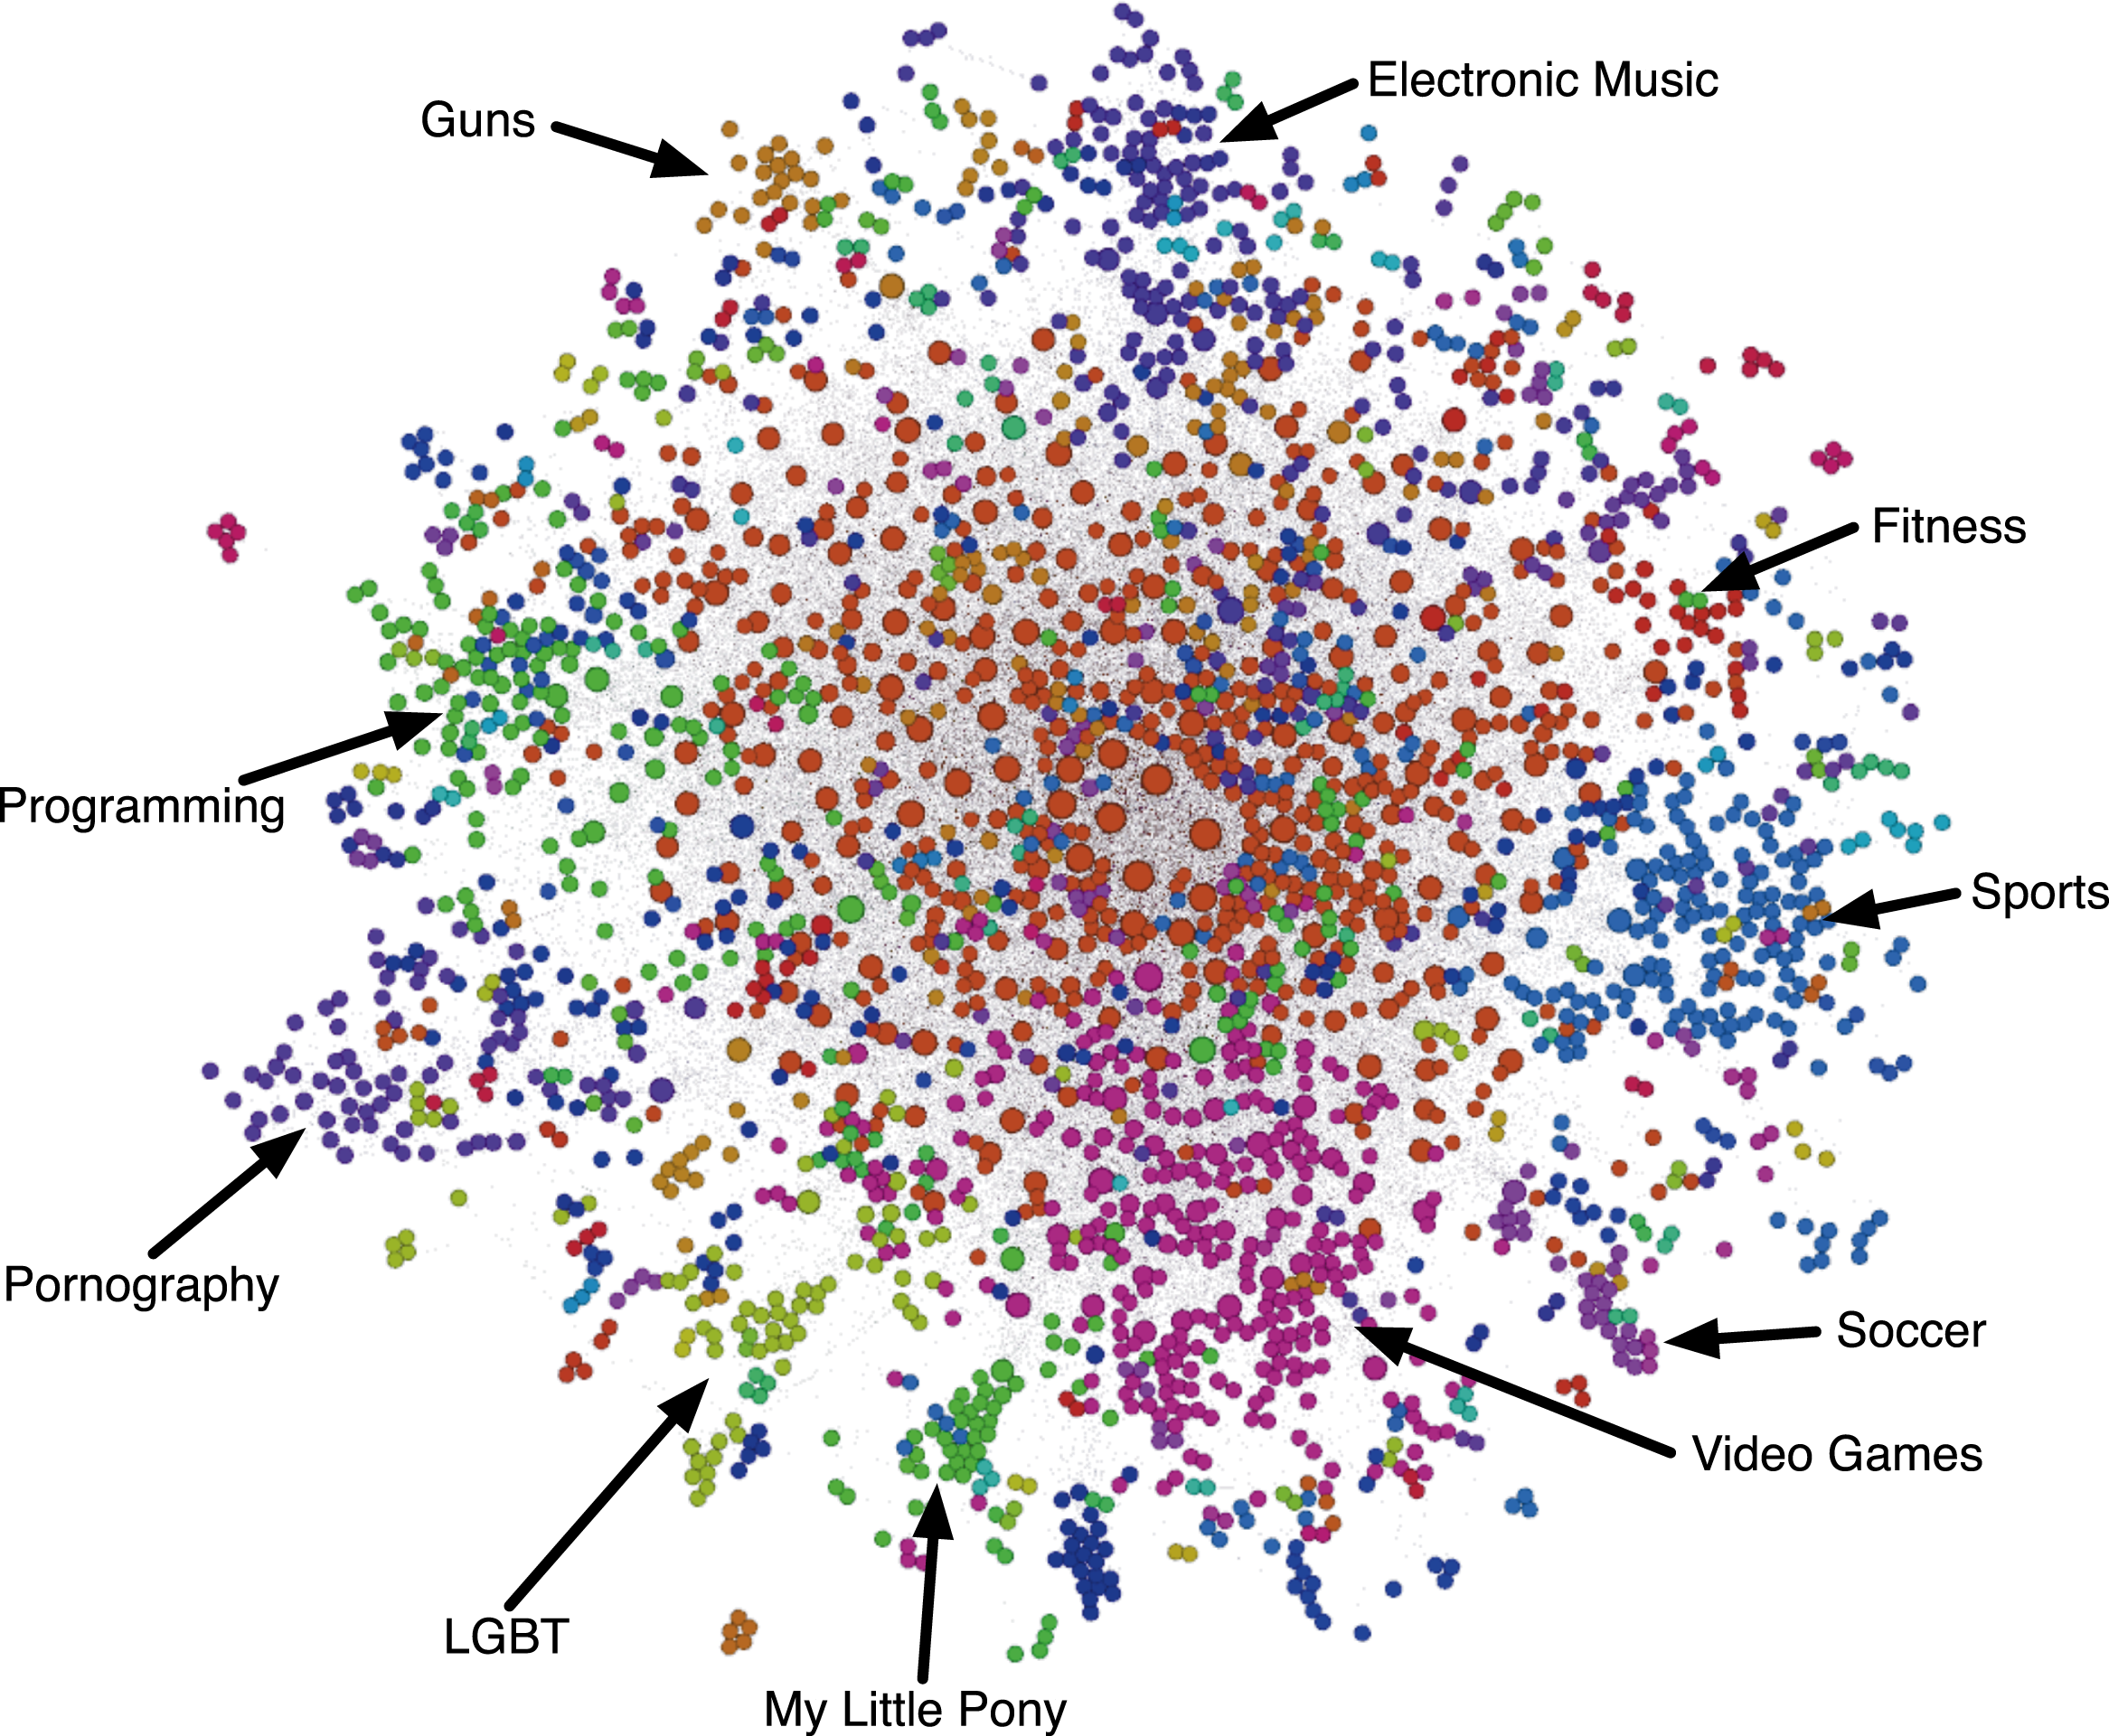
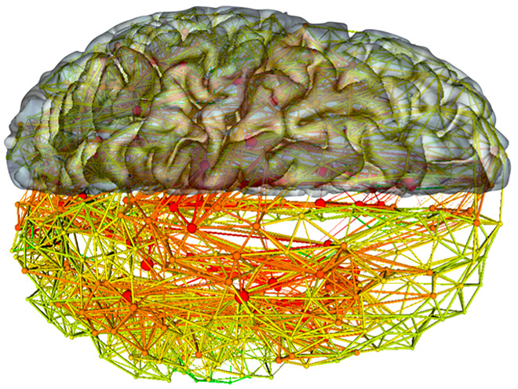
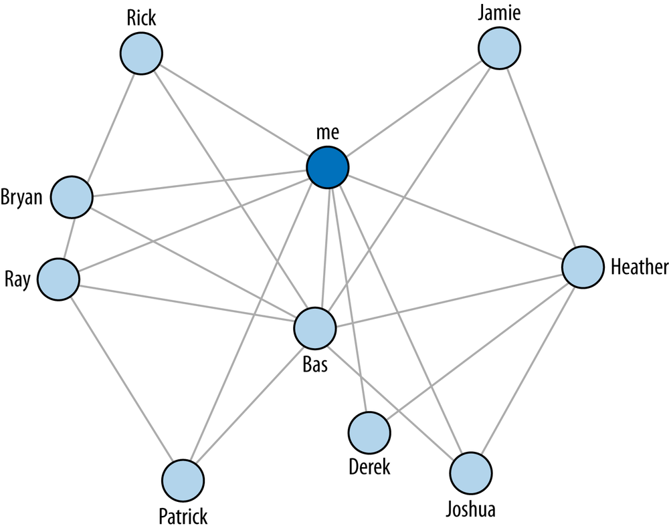
Notes:
Without knowing anything about this system, what is one thing you might say?
B seems to be the most “important” place – has the most connections.
B and C are seem to be more central to the graph – A and D are both on the edges

Slide 14
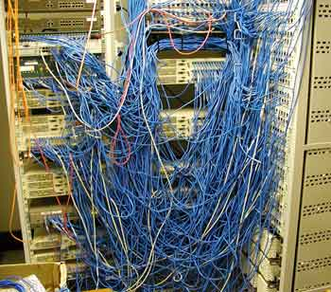
Identifying a network problem
Good way to make sense of multivariate data
Centrality
Influence
Mapping
Recommendations

Slide 15
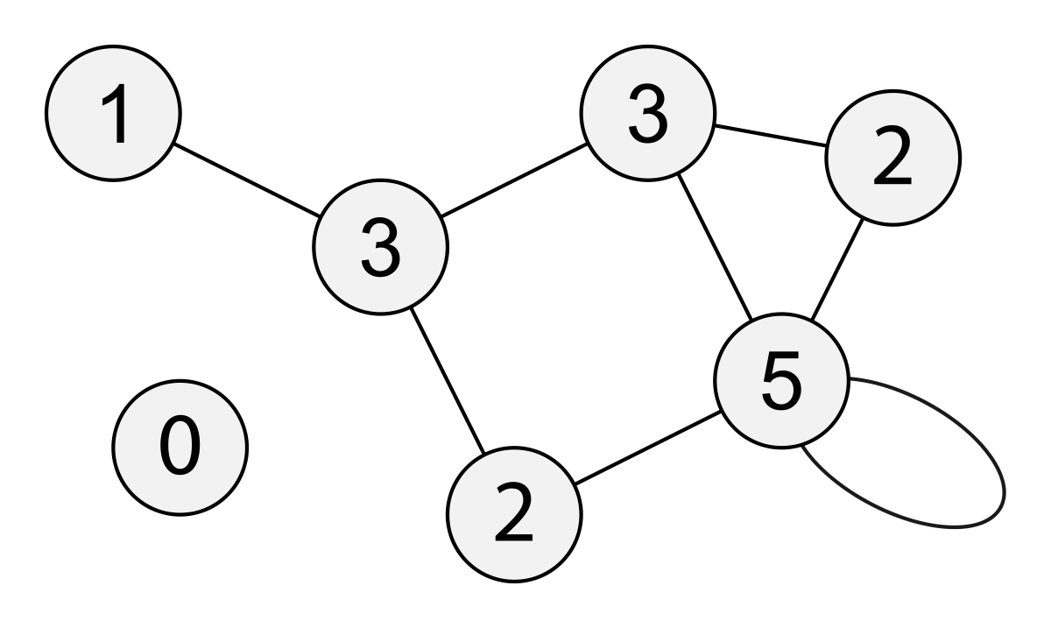
Common Measures
Degree
Notes:
Path length – average

Slide 16
Common Measures
Degree
Path Length
Notes:
Path length – average

Slide 17
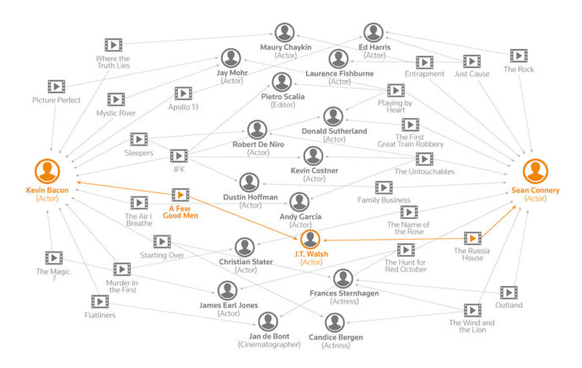

Slide 18
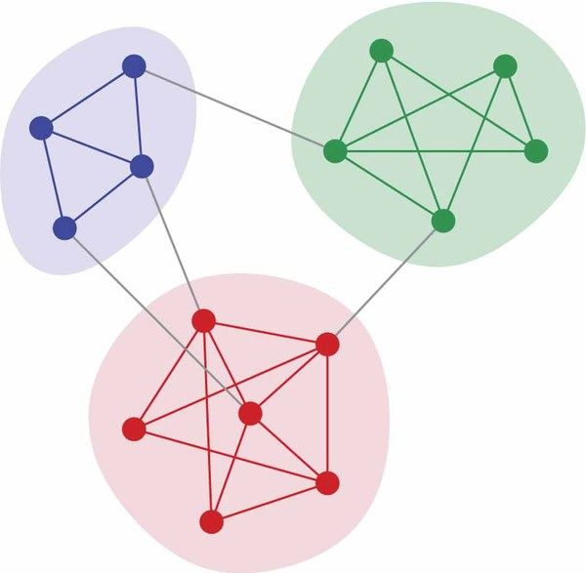
Common Measures
Degree
Path Length
Clustering
Notes:
Path length – average

Slide 19
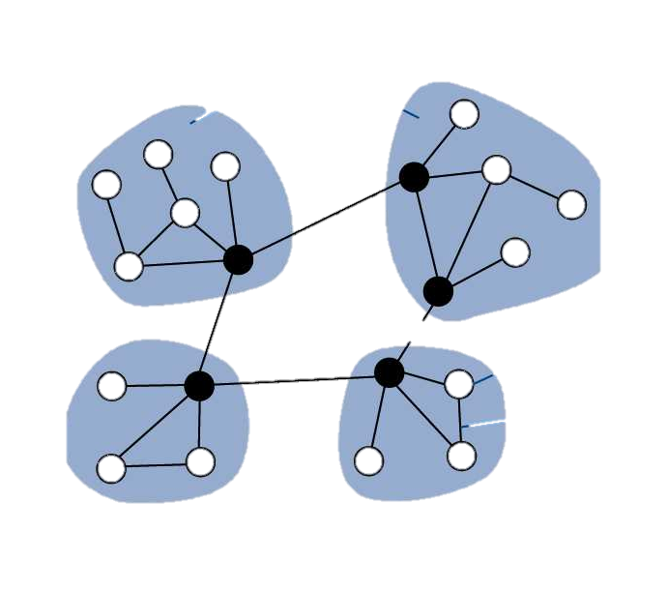
Common Measures
Degree
Path Length
Clustering
Centrality
Notes:
Path length – average

Slide 20
Now, to PyNash….

Slide 21

The MeetUp Data
Used MeetUp API to get the following information:
All groups within 25 miles of Nashville.
All members of those groups.
All events for each group and who RSVPed yes.
(Everything is on Github)

Slide 22
PyNash Relationships
We have >1400 members. But not all of them come to every meeting. (And many don’t come to any meetings.)
So we want to build a graph where…
each node is EITHER a person or event
Each edge represents attendance at that event

Slide 23
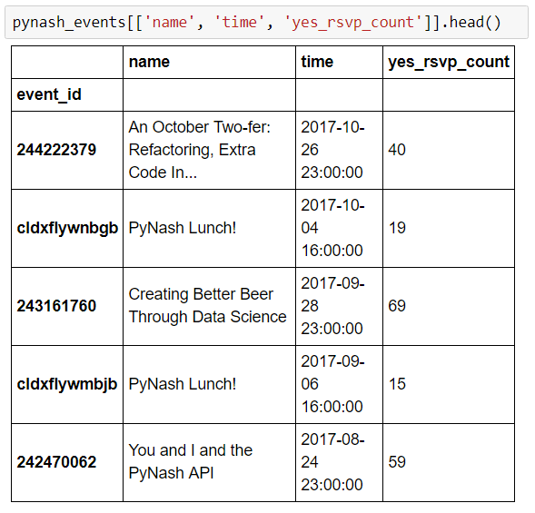
Building a graph: The data

Slide 24
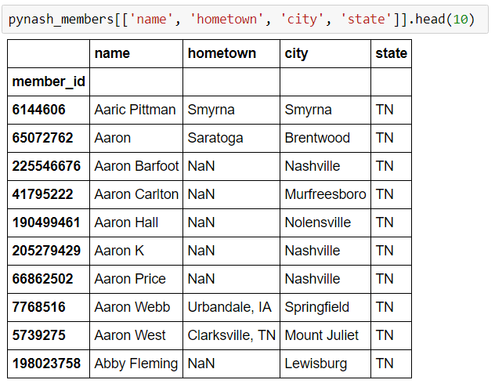
Building a graph: The data

Slide 25
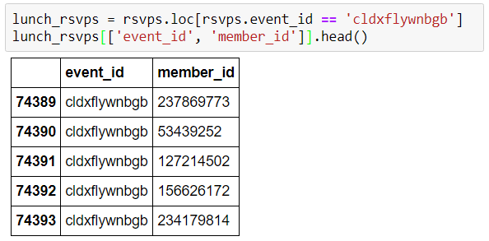
Building a graph: The data

Slide 26
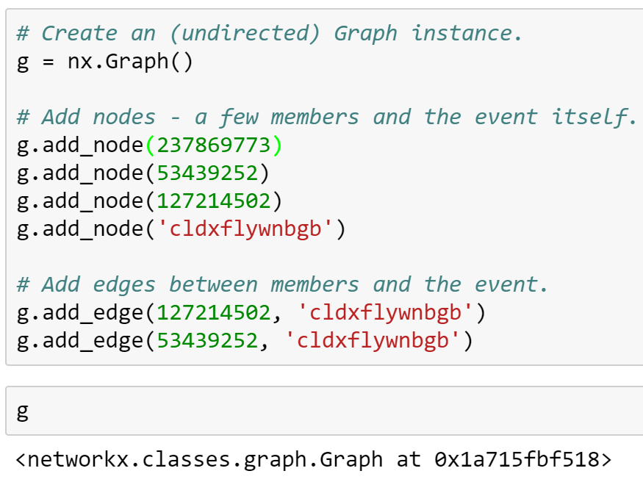
Building a graph: Declarative Syntax

Slide 27
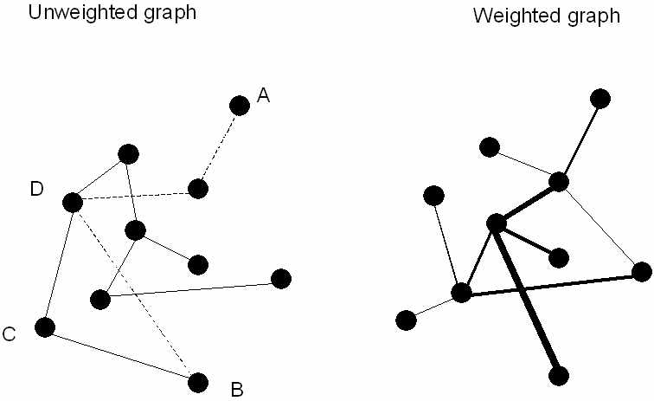
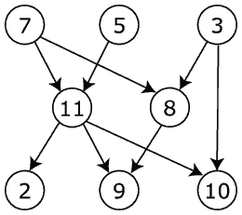
Building a graph: Sidenote on Graph Types
UNDIRECTED
DIRECTED

Slide 28
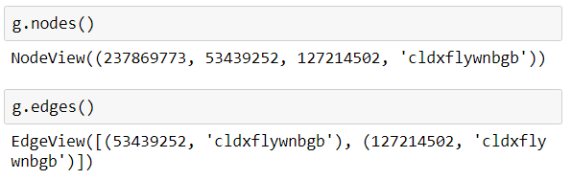
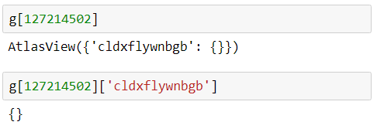
Slicing the graph
Graphs are setup as dicts-of-dicts-of-dicts.
Source: Target: Attrs

Slide 29
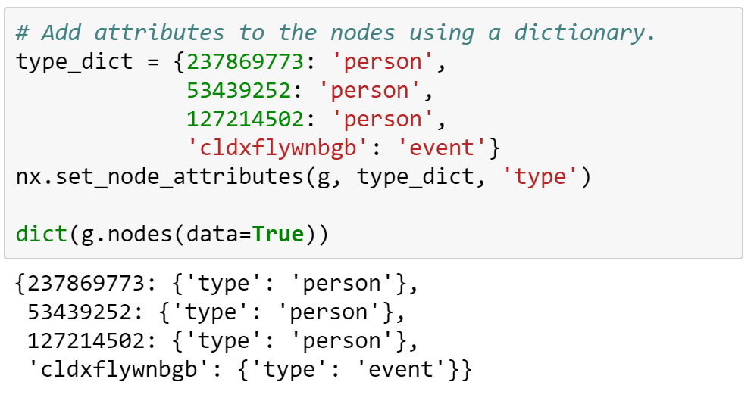
Adding attributes

Slide 30
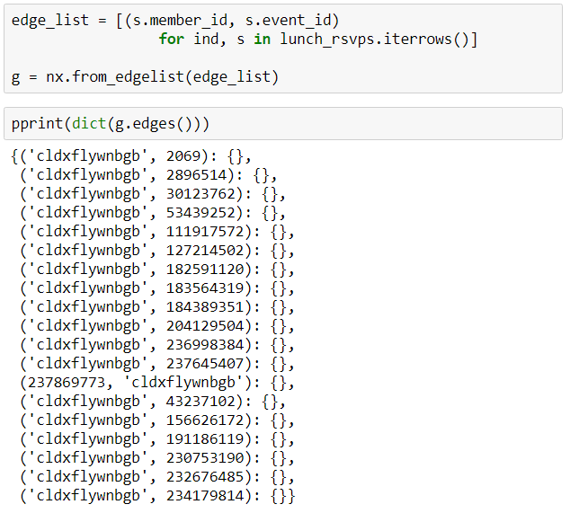
Building a graph: From an edge list

Slide 31
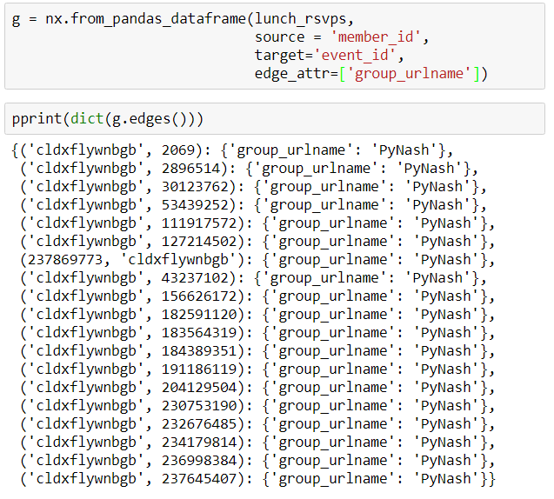
Building a Graph: From Pandas DF

Slide 32
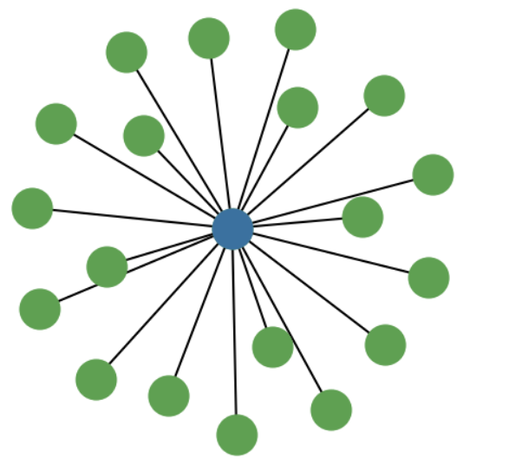
The lunch graph
Degree of the event = 19 (RSVPs)
Degree of the members = 1 (event attended)

Slide 33
Project Bipartitate Graphs (Person, Event) to (Person, Person)
We want to take

Slide 34
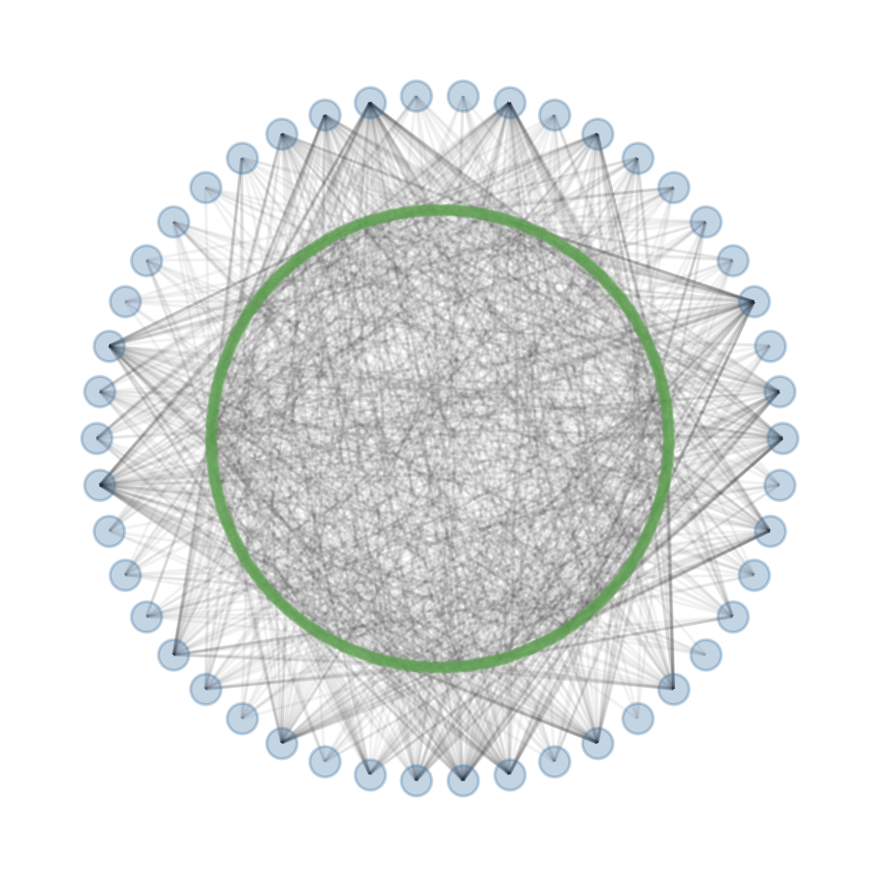
Current Graph Structure

Slide 35
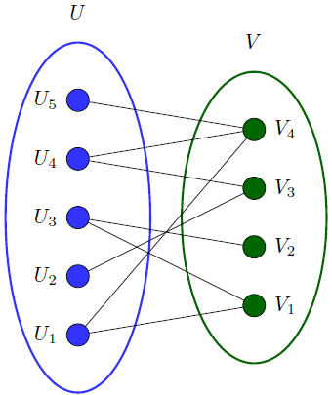
Bipartite Graphs
Great initial starting place for some datasets.
Can take the form of (Person node → Affiliation node)
e.g. (Sports fan → Sports team)

Slide 36
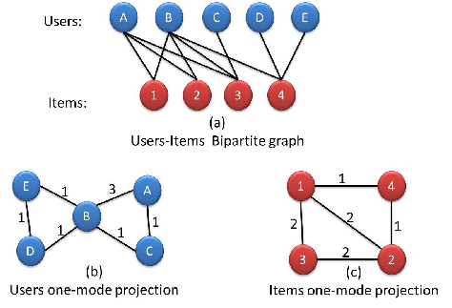

Slide 37
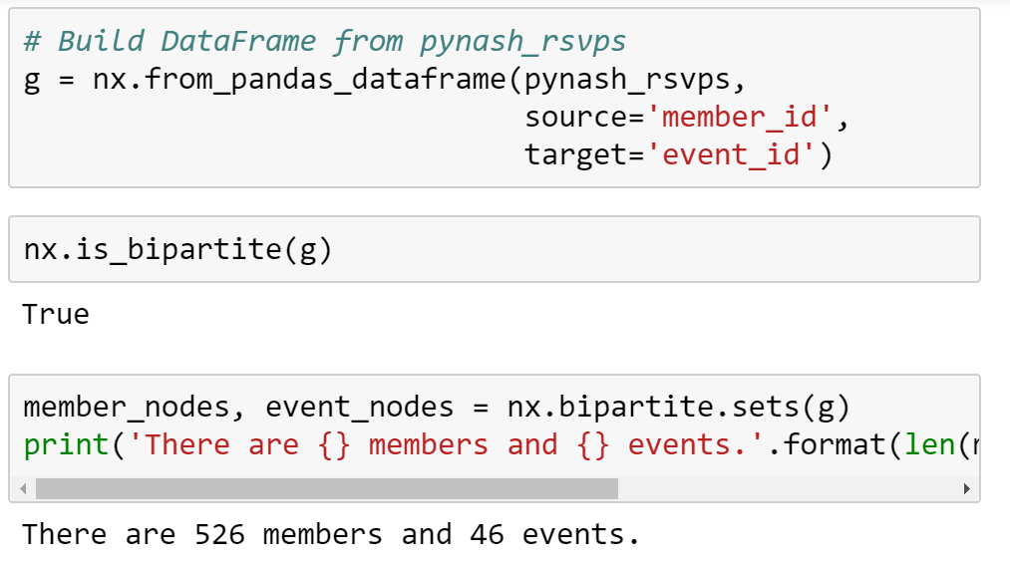
Reformatting the PyNash Graph

Slide 38
Building the PyNash Graph

Slide 39
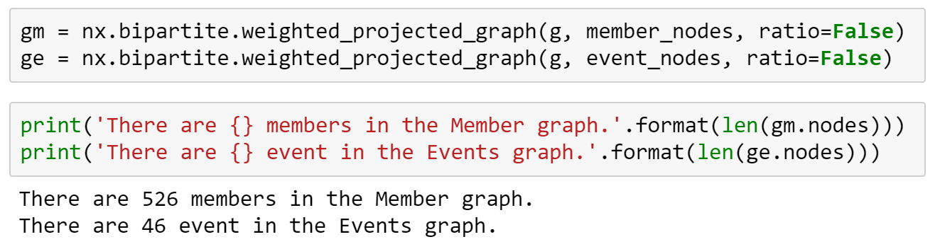
Projecting the graph

Slide 40
The final product
Now we have a graph with the following attributes:
Node: a person who attended at least one event in the past two years
Edge: shared event between two people
Edge weight: the number of shared events

Slide 41
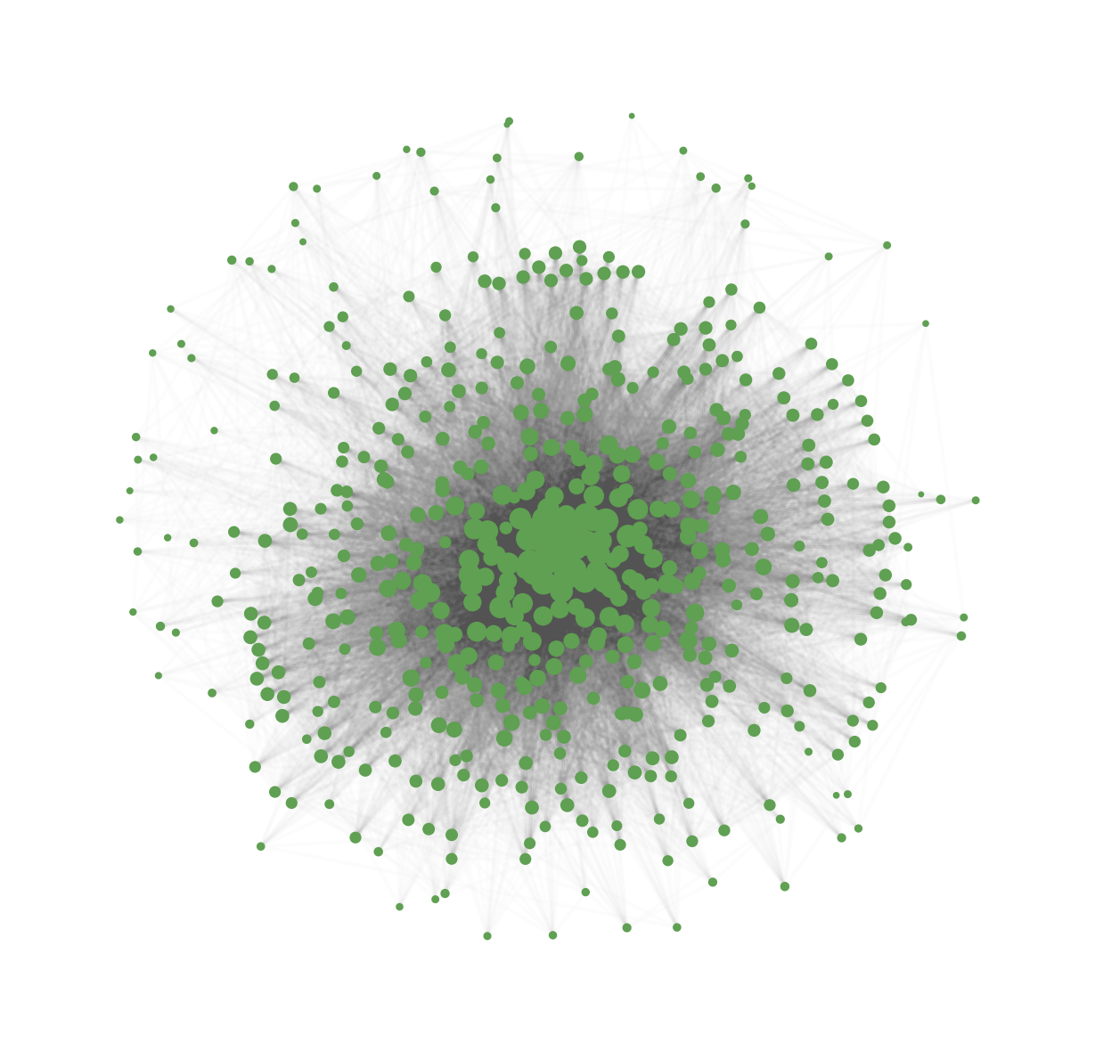
Member Structure

Slide 42
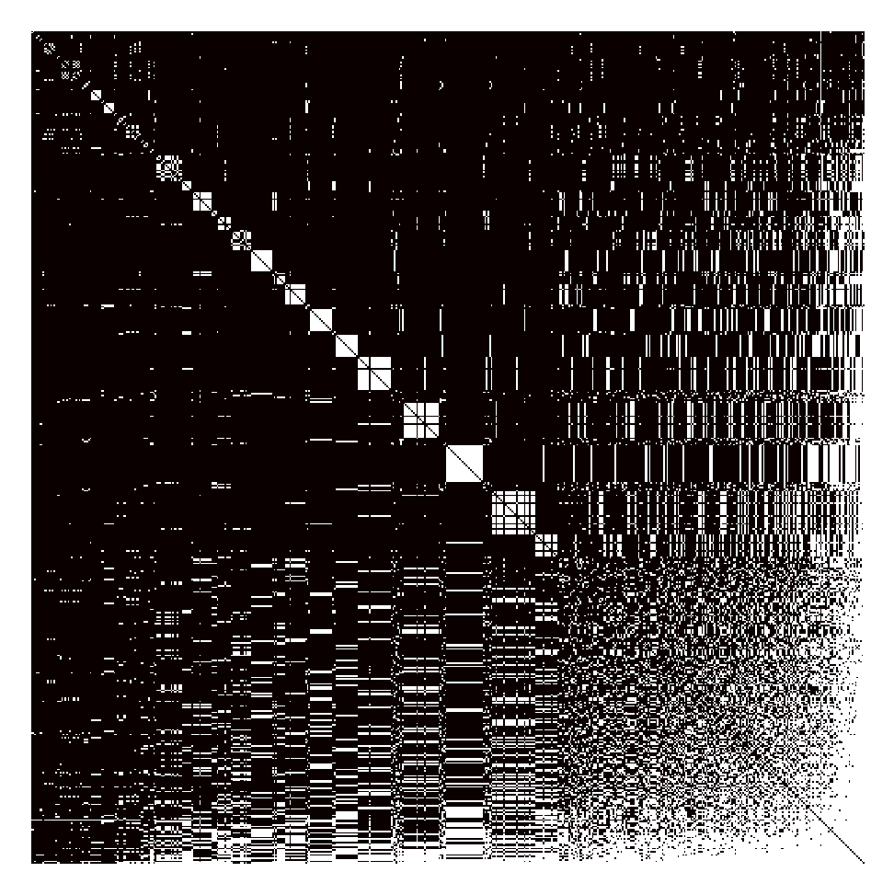
Adjacency Matrix
Matrix representation of graph edges
N*N binary array

Slide 43
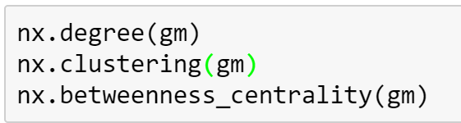
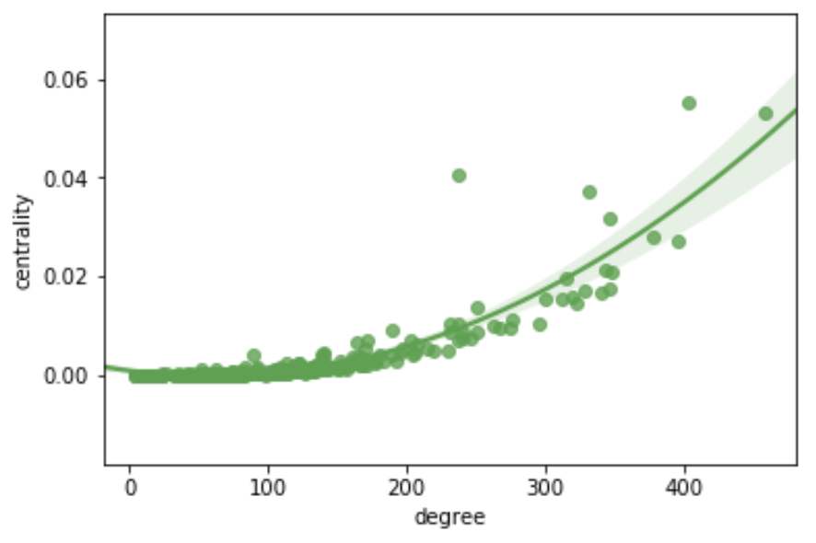
Getting network measures

Slide 44
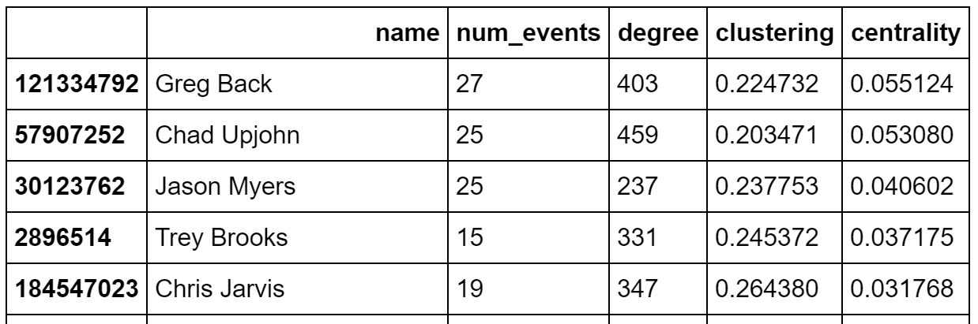
Top Five Most “central” Pythonistas

Slide 45
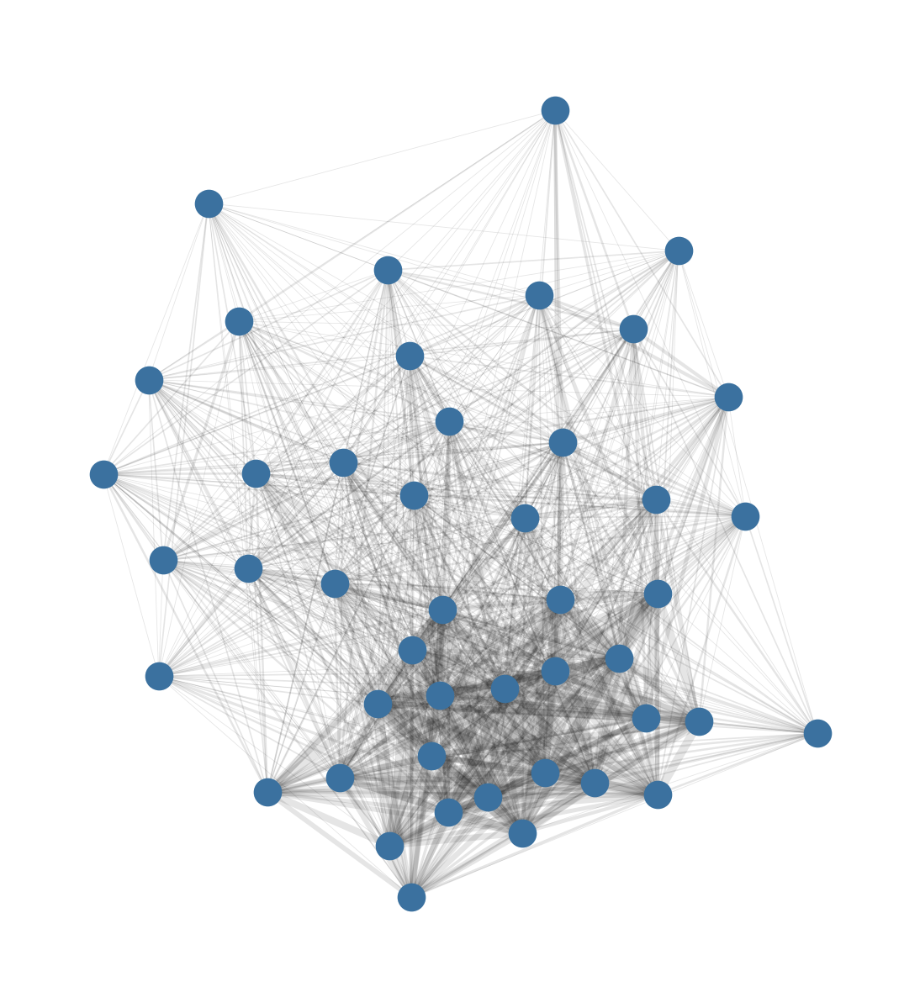
Why high degree but less central?

